Slide 1
Chapter 11: Basic I/O Interface

Slide 2
Introduction
This chapter outlines some of the basic methods of communications, both serial and parallel, between humans or machines and the microprocessor.
We first introduce the basic I/O interface and discuss decoding for I/O devices.
Then, we provide detail on parallel and serial interfacing, both of which have a variety of applications.

Slide 3
Chapter Objectives
Upon completion of this chapter, you will be able to:
Explain the operation of the basic input and output interfaces.
Decode an 8-, 16-, and 32-bit I/O device so that they can be used at any I/O port address.
Define handshaking and explain how to use it with I/O devices.
Interface and program the 82C55 programmable parallel interface.

Slide 4
Chapter Objectives
(cont.)
Upon completion of this chapter, you will be able to:
Interface LCD displays, LED displays, keyboards, ADC, DAC, and various other devices to the 82C55.
Interface and program the 16550 serial communications interface adapter.
Interface and program the 8254 programmable interval timer.

Slide 5
Chapter Objectives
(cont.)
Upon completion of this chapter, you will be able to:
Interface an analog-to-digital converter and a digital-to-analog converter to the microprocessor.
Interface both DC and stepper motors to the microprocessor.

Slide 6
11–1 INTRO TO I/O INTERFACE
I/O instructions (IN, INS, OUT, and OUTS) are explained.
Also isolated (direct or I/O mapped I/O) and memory-mapped I/O, the basic input and output interfaces, and handshaking.
Knowledge of these topics makes it easier to understand the connection and operation of the programmable interface components
and I/O techniques.

Slide 7
The I/O Instructions
One type of instruction transfers information
to an I/O device (OUT).
Another reads from an I/O device (IN).
Instructions are also provided to transfer strings of data between memory and I/O.
  INS and OUTS, found except the 8086/8088

Slide 8
Instructions that transfer data between an I/O device and the microprocessor’s accumulator (AL, AX, or EAX) are called IN and OUT.
The I/O address is stored in register DX as a 16-bit address or in the byte (p8) immediately following the opcode as an 8-bit address.
  Intel calls the 8-bit form (p8) a fixed address because it is stored with the instruction, usually
  in a ROM
The 16-bit address is called a variable address because it is stored in a DX, and then used to address the I/O device.

Slide 9
Other instructions that use DX to address
I/O are the INS and OUTS instructions.
I/O ports are 8 bits in width.
  a 16-bit port is actually two consecutive 8-bit
  ports being addressed
  a 32-bit I/O port is actually four 8-bit ports

Slide 10
When data are transferred using IN or OUT, the I/O address, (port number or simply port), appears on the address bus.
External I/O interface decodes the port number in the same manner as a memory address.
  the 8-bit fixed port number (p8) appears on address bus connections A₇–A₀ with bits
  A₁₅–A₈ equal to 00000000₂
  connections above A₁₅ are undefined for
  I/O instruction

Slide 11
The 16-bit variable port number (DX)
appears on address connections A₁₅–A₀.
The first 256 I/O port addresses (00H–FFH) are accessed by both fixed and variable I/O instructions.
  any I/O address from 0100H to FFFFH
  is only accessed by the variable I/O address
In a PC computer, all 16 address bus bits
are decoded with locations 0000H–03FFH.
  used for I/O inside the PC on the ISA
  (industry standard architecture) bus

Slide 12
INS and OUTS instructions address an I/O device using the DX register.
  but do not transfer data between accumulator
  and I/O device as do the IN/OUT instructions
  Instead, they transfer data between memory
  and the I/O device
Pentium 4 and Core2 operating in the 64-bit mode have the same I/O instructions.
There are no 64-bit I/O instructions in the 64-bit mode.
  most I/O is still 8 bits and likely will remain so

Slide 13
Isolated and Memory-Mapped I/O
Two different methods of interfacing I/O: isolated I/O and memory-mapped I/O.
In isolated I/O, the IN, INS, OUT, and OUTS transfer data between the microprocessor’s accumulator or memory and the I/O device.
In memory-mapped I/O, any instruction that references memory can accomplish the transfer.
The PC does not use memory-mapped I/O.

Slide 14
Isolated I/O
The most common I/O transfer technique
used in the Intel-based system is isolated I/O.
  isolated describes how I/O locations are isolated from memory in a separate I/O address space
Addresses for isolated I/O devices, called ports, are separate from memory.
Because the ports are separate, the user can expand the memory to its full size without using any of memory space for I/O devices.

Slide 15
A disadvantage of isolated I/O is that data transferred between I/O and microprocessor must be accessed by the IN, INS, OUT, and OUTS instructions.
Separate control signals for the I/O space are developed (using M/IO and W/R ), which indicate an I/O read (IORC) or an I/O write (RD) operation.
These signals indicate an I/O port address, which appears on the address bus, is used
to select the I/O device.

Slide 16
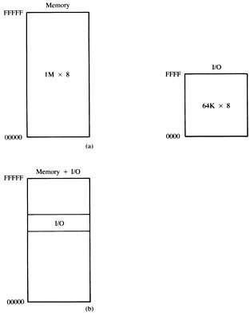
Figure 11–1 The memory and I/O maps for the 8086/8088 microprocessors. (a) Isolated I/O. (b) Memory-mapped I/O.
  in the PC, isolated I/O
  ports are used to control peripheral devices
  an 8-bit port address is used to access devices located on the system board, such as the timer and keyboard interface
  a 16-bit port is used to access serial and parallel ports, video and disk drive systems

Slide 17
Memory-Mapped I/O
Memory-mapped I/O does not use the IN, INS, OUT, or OUTS instructions.
It uses any instruction that transfers data between the microprocessor and memory.
  treated as a memory location in memory map
Advantage is any memory transfer instruction can access the I/O device.
Disadvantage is a portion of memory system is used as the I/O map.
  reduces memory available to applications

Slide 18
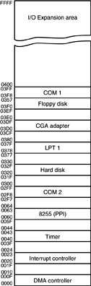
Figure 11–2 I/O map of a personal computer illustrating many of the fixed I/O areas.
Personal Computer I/O Map
  the PC uses part of I/O map for
  dedicated functions, as shown here
  I/O space between ports 0000H and 03FFH is normally reserved for the system and ISA bus
  ports at 0400H–FFFFH are generally available for user applications, main-board functions, and the PCI bus
  80287 coprocessor uses 00F8H–00FFH, so Intel reserves I/O ports 00F0H–00FFH

Slide 19
Basic Input and Output Interfaces
The basic input device is a set of three-state buffers.
The basic output device is a set of data latches.
The term IN refers to moving data from the
I/O device into the microprocessor and
The term OUT refers to moving data out of
the microprocessor to the I/O device.

Slide 20
The Basic Input Interface
Three-state buffers are used to construct the 8-bit input port depicted in Figure 11–3.
External TTL data are connected to the inputs of the buffers.
  buffer outputs connect to the data bus
The circuit of allows the processor to read the contents of the eight switches that connect to any 8-bit section of the data bus when the select signal becomes a logic 0.

Slide 21
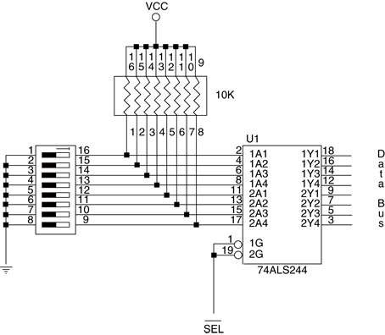
Figure 11–3 The basic input interface illustrating the connection of eight switches. Note that the 74ALS244 is a three-state buffer that controls the application of the switch data to the data bus.

Slide 22
When the IN instruction executes, contents
of the switches copy to the AL register.
This basic input circuit is not optional and must appear any time input data are interfaced to the microprocessor.
Sometimes it appears as a discrete part of the circuit, as shown in Figure 11–3.
  also built into a programmable I/O devices
Sixteen- or 32-bit data can also be interfaced but is not nearly as common as 8-bit data.

Slide 23
The Basic Output Interface
Receives data from the processor and usually must hold it for some external device.
  latches or flip-flops, like buffers in the input
  device, are often built into the I/O device
Fig 11–4 shows how eight light-emitting diodes (LEDs) connect to the processor through a set of eight data latches.
The latch stores the number output by the microprocessor from the data bus so that the LEDs can be lit with any 8-bit binary number.

Slide 24
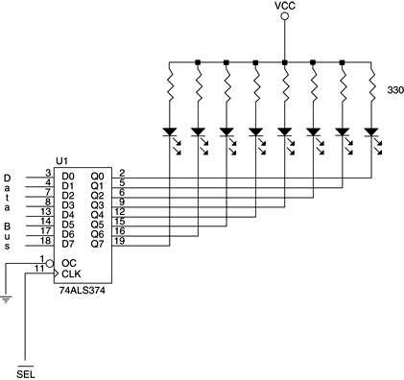
Figure 11–4 The basic output interface connected to a set of LED displays.

Slide 25
Latches hold the data because when the processor executes an OUT, data are only present on the data bus for less than 1.0 µs.
  the viewer would never see the LEDs illuminate
When the OUT executes, data from AL, AX, or EAX transfer to the latch via the data bus.
Each time the OUT executes, the SEL signal activates, capturing data to the latch.
  data are held until the next OUT
When the output instruction is executed, data from the AL register appear on the LEDs.

Slide 26
Handshaking
Many I/O devices accept or release information slower than the microprocessor.
A method of I/O control called handshaking or polling, synchronizes the I/O device with the microprocessor.
An example is a parallel printer that prints a few hundred characters per second (CPS).
The processor can send data much faster.
  a way to slow the microprocessor down to match speeds with the printer must be developed

Slide 27
Fig 11–5 illustrates typical input and output connections found on a printer.
  data transfers via data connections (D₇–D₀)
ASCII data are placed on D₇–D₀, and a pulse is then applied to the STB connection.
  BUSY indicates the printer is busy
  STB is a clock pulse used to send data to printer
The strobe signal sends or clocks the data into the printer so that they can be printed.
  as the printer receives data, it places logic 1 on the BUSY pin, indicating it is printing data

Slide 28
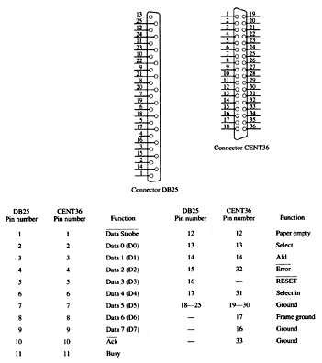
Figure 11–5 The DB25 connector found on computers and the Centronics 36-pin connector found on printers for the Centronics parallel printer interface.

Slide 29
The software polls or tests the BUSY pin to decide whether the printer is busy.
  If the printer is busy, the processor waits
  if not, the next ASCII character goes to the printer
This process of interrogating the printer, or any asynchronous device like a printer, is called handshaking or polling.

Slide 30
Input Devices
Input devices are already TTL and compatible, and can be connected to the microprocessor and its interfacing components.
  or they are switch-based
Switch-based devices are either open or connected; These are not TTL levels.
  TTL levels are a logic 0 (0.0 V–0.8 V)
  or a logic 1 (2.0 V–5.0 V)
Using switch-based device as TTL-compatible input requires conditioning applied.

Slide 31
Fig 11–6 shows a toggle switch properly connected to function as an input device.
A pull-up resistor ensures when the switch is open, the output signal is a logic 1.
  when the switch is closed, it connects to
  ground, producing a valid logic 0 level
A standard range of values for pull-up resistors is between 1K Ohm and 10K Ohm.

Slide 32
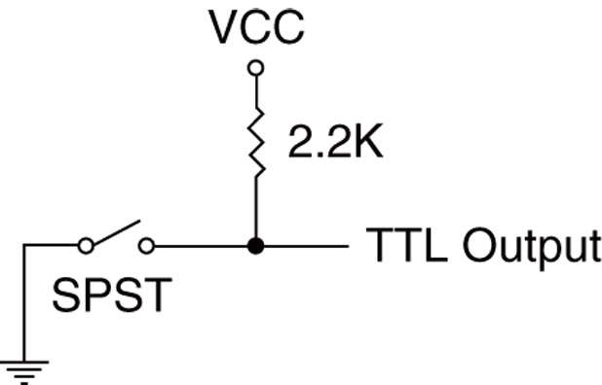
Figure 11–6 A single-pole, single-throw switch interfaced as a TTL device.

Slide 33
Mechanical switch contacts physically bounce when they are closed,
  which can create a problem if a switch is used
  as a clocking signal for a digital circuit
To prevent problems with bounces, one of the circuits shown in Fig 11–7 can be used.
  the first is a classic textbook bounce eliminator
  second is a more practical version of the same
The first version costs more to construct
  the second costs requires no pull-up resistors
  and two inverters instead of two NAND gates

Slide 34
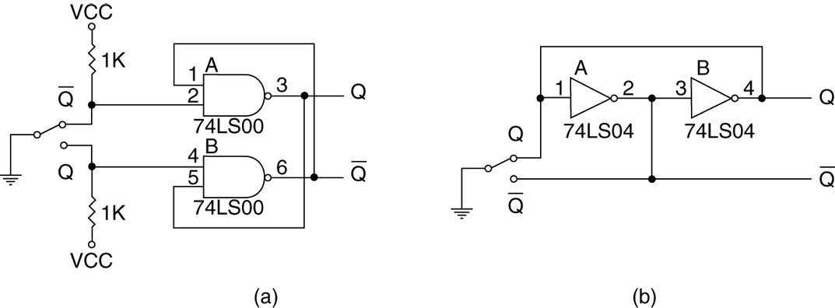
Figure 11–7 Debouncing switch contacts: (a) conventional debouncing and (b) practical debouncing.
  as the Q input from the switch becomes a logic 0, it changes the state of the flip-flop
  if the contact bounces away from the Q input, the flip-flop remembers, no change occurs, and thus no bounce

Slide 35
Output Devices
Output devices are more diverse than input devices, but many are interfaced in a uniform manner.
Before an output device can be interfaced, we must understand voltages and currents from the microprocessor or TTL interface.
Voltages are TTL-compatible from the microprocessor of the interfacing element.
  logic 0 = 0.0 V to 0.4 V
  logic 1 = 2.4 V to 5.0 V

Slide 36
Currents for a processor and many interfacing components are less than for standard TTL.
  Logic 0 = 0.0 to 2.0 mA
  logic 1 = 0.0 to 400 µA
Fig 11–8 shows how to interface a simple LED to a microprocessor peripheral pin.
  a transistor driver is used in 11–8(a)
  a TTL inverter is used in 11–8(b)
The TTL inverter (standard version) provides up to 16 mA of current at a logic 0 level
  more than enough to drive a standard LED

Slide 37
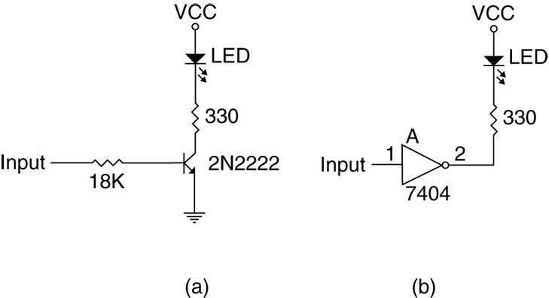
Figure 11–8 Interfacing an LED: (a) using a transistor and (b) using an inverter.

Slide 38
TTL input signal has minimum value of 2.4 V
Drop across emitter-base junction is 0.7 V.
The difference is 1.7 V
  the voltage drop across the resistor
The value of the resistor is 1.7 V ÷ 0.1 mA or 17K W.
  as 17K W is not a standard value, an 18K W resistor is chosen

Slide 39
In 11–8(a), we elected to use a switching transistor in place of the TTL buffer.
  2N2222 is a good low-cost, general-purpose switching transistor with a minimum gain of 100
  collector current is 10 mA; so base current will
  be 1/100 of collector current of 0.1 mA
To determine the value of the base current–limiting resistor, use the 0.1 mA base current and a voltage drop of 1.7 V across the base current–limiting resistor.

Slide 40
Suppose we need to interface a 12 V DC 1A motor to the microprocessor.
We cannot use a TTL inverter:
  12 V signal would burn out the inverter
  current far exceeds 16 mA inverter maximum
We cannot use a 2N2222 transistor:
  maximum current is 250 mA to 500 mA, depending on the package style chosen
The solution is to use a Darlington-pair, such as a TIP120.
  costs 25¢, can handle 4A current with heat sink

Slide 41
Fig 11–9 illustrates a motor connected to the Darlington-pair with a minimum current gain
of 7000 and a maximum current of 4A.
Value of the bias resistor is calculated exactly the same as the one used in the LED driver.
The current through the resistor is 1.0 A ÷ 7000, or about 0.143 mA.
Voltage drop is 0.9 V because of the two diode drops (base/emitter junctions).
The value of the bias resistor is 0.9 V ÷ 0.143 mA or 6.29K W.

Slide 42
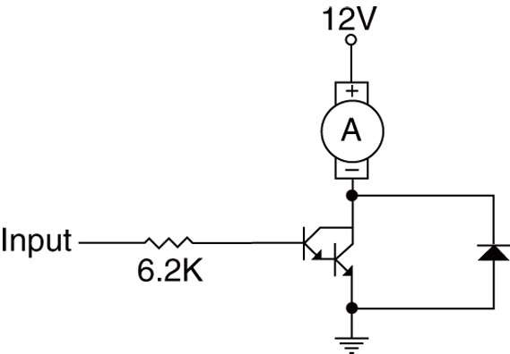
Figure 11–9 A DC motor interfaced to a system by using a Darlington-pair.
  The Darlington-pair must use
  a heat sink because of the
  amount of current
  the diode must be present to
  prevent the Darlington-pair
  from being destroyed by
  inductive kickback

Slide 43
11–2 I/O PORT ADDRESS DECODING
Very similar to memory address decoding, especially for memory-mapped I/O devices.
The difference between memory decoding
and isolated I/O decoding is the number of address pins connected to the decoder.
In the personal computer system, we always decode all 16 bits of the I/O port address.

Slide 44
Decoding 8-Bit I/O Port Addresses
Fixed I/O instruction uses an 8-bit I/O port address that on A₁₅–A₀ as 0000H–00FFH.
  we often decode only address connections
  A₇–A₀ for an 8-bit I/O port address
The DX register can also address I/O ports 00H–FFH.
If the address is decoded as an 8-bit address, we can never include I/O devices using a 16-bit address.
  the PC never uses or decodes an 8-bit address

Slide 45
Figure 11–10 shows a 74ALS138 decoder that decodes 8-bit I/O ports F0H - F7H.
  identical to a memory address decoder except
  we only connect address bits A₇–A₀ to the
  inputs of the decoder
Figure 11–11 shows the PLD version, using a GAL22V10 (a low-cost device) for this decoder.
The PLD is a better decoder circuit because the number of integrated circuits has been reduced to one device.

Slide 46
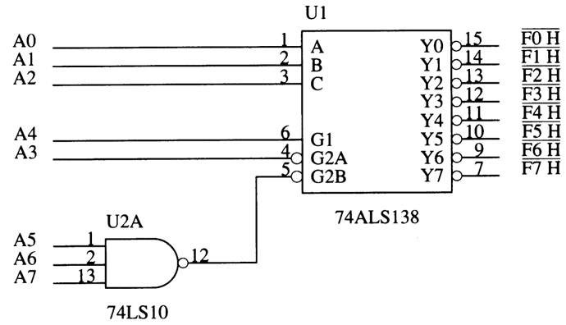
Figure 11–10 A port decoder that decodes 8-bit I/O ports. This decoder generates active low outputs for ports F0H–F7H.

Slide 47
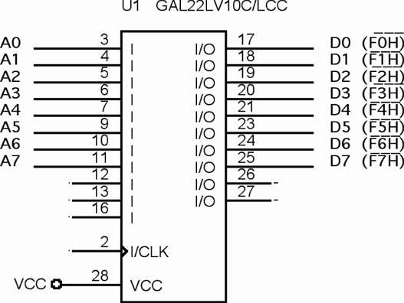
Figure 11–11 A PLD that generates part selection signals

Slide 48
Decoding 16-Bit I/O Port Addresses
PC systems typically use 16-bit I/O addresses.
  16-bit addresses rare in embedded systems
The difference between decoding an 8-bit and a 16-bit I/O address is that eight additional address lines (A₁₅–A₈) must be decoded.
Figure 11–12 illustrates a circuit that contains a PLD and a 4-input NAND gate used to decode I/O ports EFF8H–EFFFH.
PLD generates address strobes for I/O ports

Slide 49
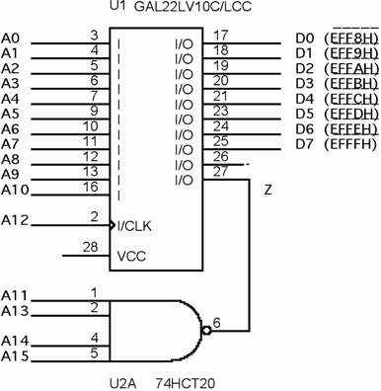
Figure 11–12 A PLD that decodes 16-bit I/O ports EFF8H through EFFFH.

Slide 50
8- and 16-Bit Wide I/O Ports
Data transferred to an 8-bit I/O device exist in one of the I/O banks in a 16-bit processor such as 80386SX.
The I/O system on such a microprocessor contains two 8-bit memory banks.
Fig 11–13 shows separate I/O banks for a
16-bit system such as 80386SX.
Because two I/O banks exist, any 8-bit I/O write requires a separate write.

Slide 51
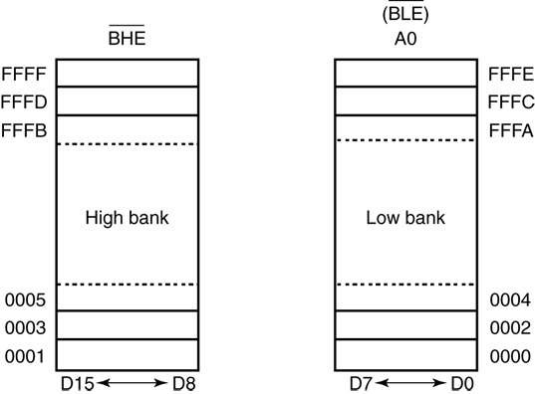
Figure 11–13 The I/O banks found in the 8086, 80186, 80286, and 80386SX.

Slide 52
I/O reads don’t require separate strobes.
  as with memory, the processor reads only the byte it expects and ignores the other byte
  a read can cause problems when an I/O device responds incorrectly to a read operation
Fig 11–14 showss a system with two different 8-bit output devices, located at 40H and 41H.
These are 8-bit devices and appear in different I/O banks.
  thus, separate I/O write signals are generated to clock a pair of latches that capture port data

Slide 53
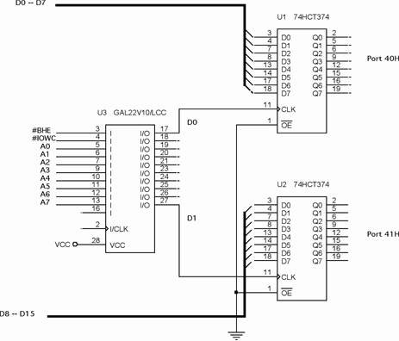
Figure 11–14 An I/O port decoder that selects ports 40H and 41H for output data.
  all I/O ports use 8-bit addresses
  ports 40H & 41H can be addressed as separate 8-bit ports
  or as one
  16-bit port

Slide 54
Fig 11–15 shows a 16-bit device connected
to function at 8-bit addresses 64H & 65H.
The PLD decoder does not have a connection for address bits BLE (A₀) and BHE because the signals don’t apply to 16-bit-wide devices.
The program for the PLD, illustrated in Example 11–5, shows how the enable
signals are generated for the three-state buffers (74HCT244) used as input devices.

Slide 55
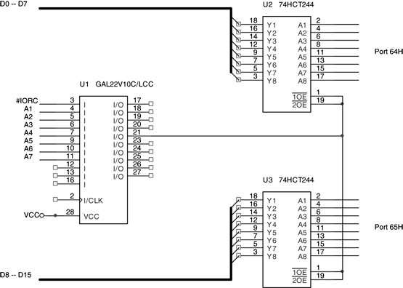
Figure 11–15 A 16-bit-wide port decoded at I/O addresses 64H and 65H.

Slide 56
32-Bit-Wide I/O Ports
May eventually become common because of newer buses found in computer systems.
The EISA system bus supports 32-bit I/O as well as the VESA local and current PCI bus.
  not many I/O devices are 32 bits in width
Fig 11–16 shows a 32-bit input port for 80386DX - 80486DX microprocessor.
The circuit uses a single PLD to decode the I/O ports and four 74HCT244 buffers to connect the I/O data to the data bus.

Slide 57
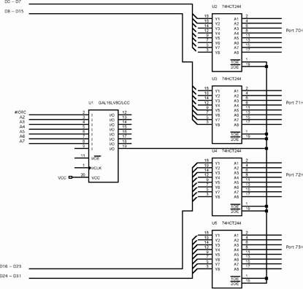
Figure 11–16 A 32-bit-wide port decoded at 70H through 73H for the 80486DX microprocessor.
  I/O ports decoded by this interface are the 8-bit ports 70H–73H
  When writing to access this port, it is crucial to use the address 70H for 32-bit input
  as instruction
  IN EAX, 70H

Slide 58
With the Pentium–Core2 and their 64-bit data buses, I/O ports appear in various banks, as determined by the I/O port address.
A 32-bit I/O access in the Pentium system
can appear in any four consecutive I/O banks.
  32-bit ports 0100H–0103H appear in banks 0–3
I/O address range must begin at a location where the rightmost two bits are zeros.
  0100H–0103H is allowable
  0101H–0104H is not

Slide 59
Widest I/O transfers are 32 bits, and there are no I/O instructions to support 64-bit transfers.
  true for Pentium 4 or Core2 in the 64-bit mode
Suppose we need to interface a 16-bit-wide output port at I/O address 2000H and 2001H.
  interface is illustrated in Figure 11–17
  PLD program is listed in Example 11–7
The problem that can arise is when the I/O port spans across a 64-bit boundary.
  example, a 16-bit- port at 2007H and 2008H

Slide 60
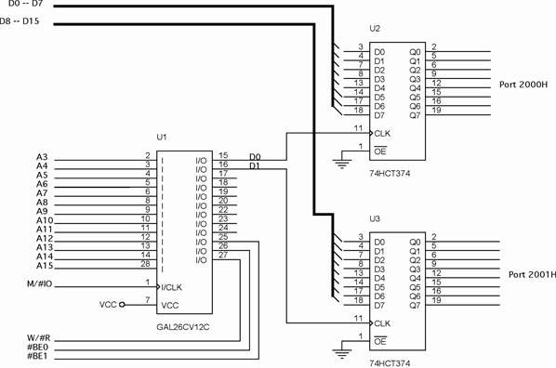
Figure 11–17 A Pentium 4 interfaced to a 16-bit-wide I/O port at port addresses 2000H and 2001H.

Slide 61
11–3 THE PROGRAMMABLE PERIPHERAL
82C55 programmable peripheral interface (PPI) is a popular, low-cost interface component found in many applications.
The PPI has 24 pins for I/O, programmable in groups of 12 pins and groups that operate in three distinct modes of operation.
82C55 can interface any TTL-compatible
I/O device to the microprocessor.

Slide 62
The 82C55 (CMOS version) requires wait states if operated with a processor using higher than an 8 MHz clock.
  also provides at least 2.5 mA of sink (logic 0) current at each output, a maximum of 4.0 mA
Because I/O devices are inherently slow, wait states used during I/O transfers do not impact significantly upon the speed of the system.
The 82C55 still finds application even in the latest Core2-based computer system.

Slide 63
82C55 is used for interface to the keyboard and parallel printer port in many PCs.
  found as a function within an interfacing chip set
  also controls the timer and reads data from the keyboard interface
An experimentation board is available that plugs into the parallel port of a PC, to allow access to an 8255 located on the board.
The 8255 is programmed in either assembly language or Visual C++ through drivers available with the board.

Slide 64
Basic Description of the 82C55
Fig 11–18 shows pin-outs of the 82C55 in
DIP and surface mount (flat pack) format.
The three I/O ports (labeled A, B, and C) are programmed as groups.
  group A connections consist of port A (PA₇–PA₀) and the upper half of port C (PC₇–PC₄)
  group B consists of port B (PB₇–PB₀) and the lower half of port C (PC₃–PC₀)
82C55 is selected by its CS pin for programming and reading/writing to a port.

Slide 65
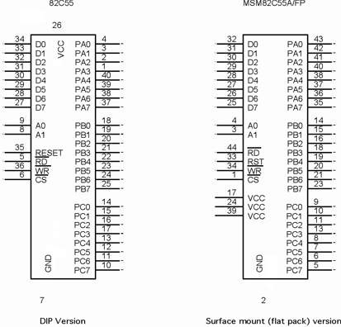
Figure 11–18 The pin-out of the 82C55 peripheral interface adapter (PPI).

Slide 66
Table 11–2 shows I/O port assignments used for programming and access to the I/O ports.
In the PC, a pair of 82C55s, or equivalents, are decoded at I/O ports 60H–63H and also
at ports 378H–37BH.
The 82C55 is a fairly simple device to interface to the microprocessor and program.
For 82C55 to be read or written, the CS input must be logic 0 and the correct I/O address must be applied to the A₁ and A₀ pins.
Remaining port address pins are don’t cares.

Slide 67
Fig 11–19 shows an 82C55 connected to the 80386SX so it functions at 8-bit addresses C0H (port A), C2H (port B), C4H (port C),
and C6H (command register).
  this interface uses the low bank of the I/O map
All 82C55 pins are direct connections to the 80386SX, except the CS pin. The pin is decoded/selected by a 74ALS138 decoder.
A RESET to 82C55 sets up all ports as
simple input ports using mode 0 operation.
  initializes the device when the processor is reset

Slide 68
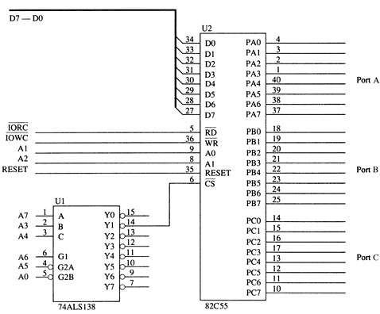
Figure 11–19 The 82C55 interfaced to the low bank of the 80386SX microprocessor.

Slide 69
After a RESET, no other commands are needed, as long as it is used as an input device for all three ports.
82C55 is interfaced to the PC at port addresses 60H–63H for keyboard control.
  also for controlling the speaker, timer, and other internal devices such as memory expansion
It is also used for the parallel printer port at I/O ports 378H–37BH.

Slide 70
Programming the 82C55
82C55 is programmed through two internal command registers shown in Figure 11–20.
Bit position 7 selects either command byte A or command byte B.
  command byte A programs functions of group
  A and B
  byte B sets (1) or resets (0) bits of port C only
  if the 82C55 is programmed in mode 1 or 2
Group B (port B and the lower part of port C) are programmed as input or output pins.

Slide 71
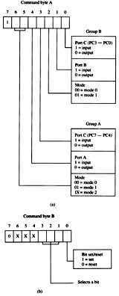
Figure 11–20 The command byte of the command register in the 82C55. (a) Programs ports A, B, and C. (b) Sets or resets the bit indicated in the select a bit field.
  group B operates in mode 0 or mode 1
  mode 0 is basic input/output mode that allows the pins of group B to be programmed as simple input and latched output connections
  Mode 1 operation is the strobed operation for group B connections
  data are transferred through port B
  handshaking signals are provided by port C

Slide 72
Group A (port A and the upper part of port C) are programmed as input or output pins.
Group A can operate in modes 0, 1, and 2.
  mode 2 operation is a bidirectional mode of operation for port A
If a 0 is placed in bit position 7 of the command byte, command byte B is selected
This allows any bit of port C to be set (1) or reset (0), if the 82C55 is operated in either mode 1 or 2.
  otherwise, this byte is not used for programming

Slide 73
Mode 0 Operation
Mode 0 operation causes 82C55 to function:
  as a buffered input device
  as a latched output device
Fig 11–21 shows 82C55 connected to a
set of eight seven-segment LED displays.
These are standard LEDs.
  the interface can be modified with a change
  in resistor values for an organic LED (OLED) display or high-brightness LEDs

Slide 74
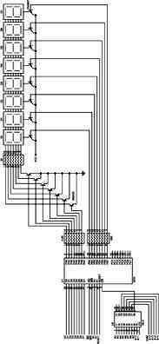
Figure 11–21 An 8-digit LED display interfaced to the 8088 microprocessor through an 82C55 PIA.
  ports A & B are programmed as
  (mode 0) simple latched output ports
  port A provides segment data inputs
  port B provides a means of selecting one display position at a time for multiplexing the displays
  the 82C55 is interfaced to an 8088 through a PLD so it functions at
  I/O port numbers 0700H–0703H
  PLD decodes the I/O address and develops the write strobe for the WR pin of the 82C55

Slide 75
Resistor values in Fig 11–21 are chosen so the segment current is 80 mA.
  required to produce average 10 mA current
  per segment as the displays are multiplexed
A six-digit display uses a segment current of 60 mA for an average of 10 mA per segment.
Peak anode current in an eight-digit display
is 560 mA (seven segments × 80 mA).
  average anode current is 80 mA
In a six-digit display, peak current would be 420 mA (seven segments × 60 mA).

Slide 76
In this display, the segment load resistor passes 80 mA current and has approximately 3.0 V across it.
The value of the resistor is 3.0 V ÷ 180 mA = 37.5 Ohm. The closest standard resistor
value of 39 Ohm is used in Fig11–21.
Programming the 82C55 is accomplished by the short sequence of instructions listed in Example 11–9.
Ports A and B are programmed as outputs.

Slide 77
An LCD Display Interfaced to the 82C55
LCDs (liquid crystal displays) have replaced LED displays in many applications.
Fig 11–22 shows an Optrex DMC-20481 LCD display interfaced to an 82C55.
  DMC-20481 is a 4-line by 20-characters-per-line display that accepts ASCII code as input data
It also accepts commands that initialize it and control its application.

Slide 78
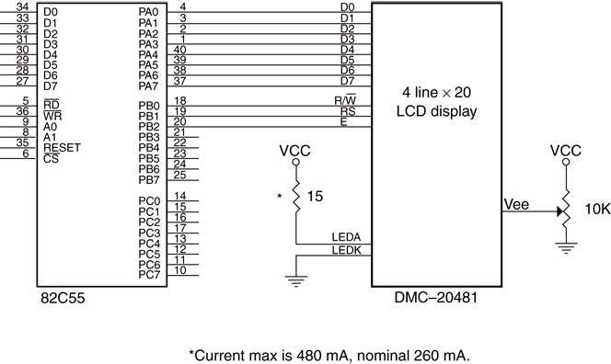
Figure 11–22 The DMC-20481 LCD display interfaced to the 82C55.

Slide 79
The data connections, which are attached to the 82C55 port A, are used to input display data and to read information from the display.
For a 4-bit interface, D₄–D₇ pins are used where the data must be formatted with the high nibble first, followed by the low nibble.
A few newer OLED devices contain a serial interface that uses a single pin for the data.

Slide 80
To program DMC-20481 it must first be initialized.
This applies to any display using the HD44780 (Hitachi) display driver IC.
The entire line of small display panels from Optrex and most other manufacturers is programmed in the same manner.
To program DMC-20481 it must first be initialized.
  this applies to any display using the HD44780 (Hitachi) display driver integrated circuit

Slide 81
Initialization is accomplished via the following:
  1. Wait at least 15 ms after V_{CC} rises to 5.0 V
  2. Output the function set command (30H), and wait at least 4.1 ms
  3. Output the function set command (30H) a second time, and wait at least 100 µs
  4. Output the function set command (30H) a
  third time, and wait at least 40 µs
  5. Output the function set command (38H) a fourth time, and wait at least 40 µs
  6. Output 08H to disable the display, and wait
  at least 40 µs

Slide 82
  7. Output a 01H to home the cursor and clear
  the display, and wait at least 1.64 ms
  8. Output the enable display cursor off (0CH),
  and wait at least 40 µs
  9. Output 06H to select auto-increment, shift
  the cursor, and wait at least 40 µs
Software to accomplish the initialization of
the LCD display is listed in Example 11–12.
The time delays can also be obtained by using a timer in C++.

Slide 83
After initialization, time delays are no longer needed when sending data or many commands to the display.
The clear display command still needs a time delay as the busy flag is not used .
Instead of a time delay, the busy flag is tested to see whether the display has completed an operation.
The BUSY procedure tests the LCD display and only returns when the display has completed a prior instruction.

Slide 84
Once the BUSY procedure is available, data can be sent to the display by writing another procedure called WRITE.
The WRITE procedure uses BUSY to test before trying to write new data to the display.
Example 11–14 shows the WRITE procedure, which transfers the ASCII character from the BL register to the current cursor position of the display.

Slide 85
The only other procedure needed for a basic display is the clear & home cursor procedure, called CLS, shown in Example 11–15.
This procedure uses the SEND macro from the initialization software to send the clear command to the display.
With CLS and the procedures presented thus far, you can display any message on the display, clear it, display another message, and basically operate the display.

Slide 86
A Stepper Motor Interfaced to the 82C55.
Another device often interfaced to a computer system is the stepper motor.
  a digital motor because it is moved in discrete steps as it traverses through 360°
An inexpensive stepper motor is geared to move perhaps 15° per step
A more costly, high-precision stepper motor can be geared to 1° per step.

Slide 87
In all cases, these steps are gained through many magnetic poles and/or gearing.
Figure 11–23 shows a four-coil stepper motor that uses an armature with a single pole.
  two coils are energized
If less power is required, one coil may be energized at a time, causing the motor to
step at 45°, 135°, 225°, and 315°.
The motor is shown with the armature rotated to four discrete places, called full stepping.
  accomplished by energizing the coils, as shown

Slide 88
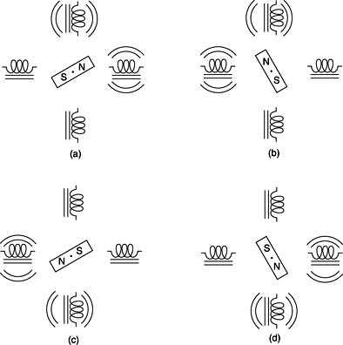
Figure 11–23 The stepper motor showing full-step operation: (a) 45° (b) 135° (c) 225° (d) 315°.

Slide 89
The motor is driven by NPN Darlington amp pairs to provide a large current to each coil.
A circuit that can drive this stepper motor is illustrated in Fig 11–24.
  with the four coils shown in place
This circuit uses the 82C55 to provide drive signals used to rotate the motor armature in either the right- or left-hand direction.
A simple procedure that drives the motor is listed in Example 11–16 in both assembly language and as a function in C++.

Slide 90
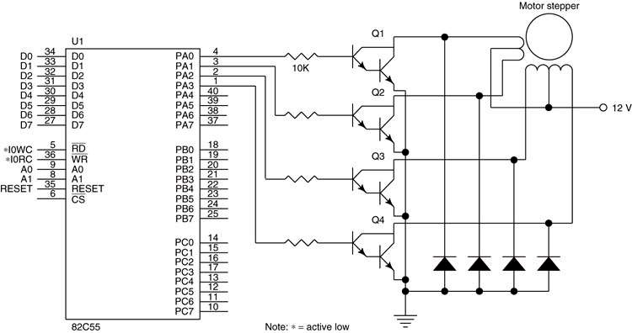
Figure 11–24 A stepper motor interfaced to the 82C55. This illustration does not show the decoder.

Slide 91
Key Matrix Interface
Keyboards come in a variety of sizes, from standard 101-key QWERTY keyboards to special keyboards that contain 4 to 16 keys.
Fig 11–25 is a key matrix with 16 switches interfaced to ports A and B of an 82C55.
  the switches are formed into a 4 × 4 matrix,
  but any matrix could be used, such as a 2 × 8
The keys are organized into four rows and columns: (ROW₀–ROW₃) (COL₀–COL₃)

Slide 92
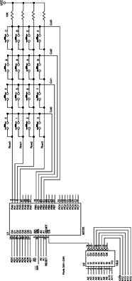
Figure 11–25 A 4 × 4 keyboard matrix connected to an 8088 microprocessor through the 82C55 PIA.
  the 82C55 is decoded at I/O
  ports 50H–53H for an 8088
  port A is programmed as an
  input port to read the rows
  port B is programmed as an output port to select a column
  a flowchart of the software required to read a key from the keyboard matrix and debounce the key is illustrated in Fig 11–26

Slide 93
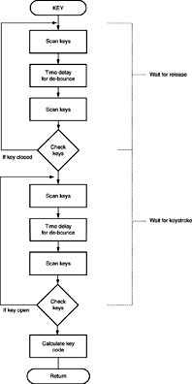
Figure 11–26 The flowchart of a keyboard-scanning procedure.
  keys must be debounced, normally with a time delay of 10–20 ms
  the software uses a procedure called SCAN to scan the keys and another called DELAY10 to waste 10 ms of time for debouncing
  the main keyboard procedure is called KEY and appears in Example 11–17
  the KEY procedure is generic, and can handle any configuration from a 1 × 1 matrix to an 8 × 8 matrix.

Slide 94
The ShortDelay procedure is needed as the computer changes port B at a very high rate .
  the time delay allows the data sent to port B to settle to their final state
This is not needed if scan rate (time between output instructions) does not exceed 30 KHz.
  if the scanning frequency is higher, the device generates radio interference
If so, the FCC will not approve application
in any accepted system
  without certification the system cannot be sold

Slide 95
Mode 1 Strobed Input
Causes port A and/or port B to function as latching input devices.
  allows external data to be stored to the port
  until the microprocessor is ready to retrieve it
Port C is used in mode 1 operation—not for data, but for control or handshaking signals.
  to help operate either or both port A and B as strobed input ports
Fig 11–27 shows how both ports are structured for mode 1 strobed input operation.

Slide 96
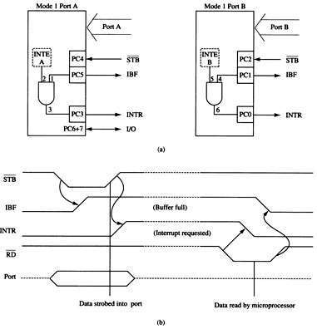
Figure 11–27 Strobed input operation (mode 1) of the 82C55. (a) Internal structure and (b) timing diagram.

Slide 97
Signal Definitions for Mode 1 Strobed Input
STB
The strobe input loads data to the port latch, which holds the information until it is input to the microprocessor via the IN instruction.
IBF
Input buffer full is an output indicating that the input latch contains information.

Slide 98
INTR
Interrupt request is an output that requests an interrupt. The INTR pin becomes a logic 1 when STB returns to a logic 1. Cleared when data are input from the port by the processor.
INTE
Interrupt enable signal is neither input nor output; it is an internal bit programmed via
port PC₄ (port A) or PC₂ (port B) bit position.

Slide 99
PC₇, PC₆
The port C pins 7 and 6 are general-purpose I/O pins that are available for any purpose.

Slide 100
Strobed Input Example
An example of a strobed input device is a keyboard.
The keyboard encoder debounces the key switches and provides a strobe signal whenever a key is depressed.
  the data output contains ASCII-coded key code
Figure 11–28 illustrates a keyboard connected to strobed input port A.

Slide 101
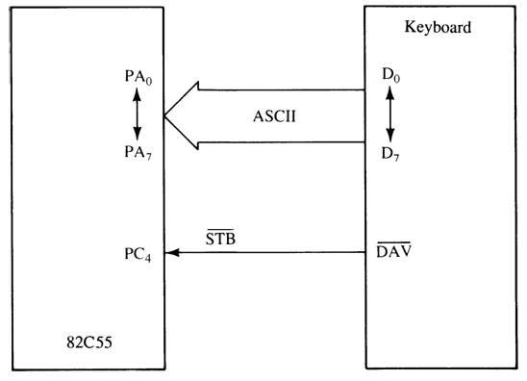
Figure 11–28 Using the 82C55 for strobed input operation of a keyboard.

Slide 102
Mode 1 Strobed Output
Fig 11–29 shows the internal configuration and timing diagram of 82C55 when operated as a strobed output device under mode 1.
Strobed output operation is similar to mode 0 output operation.
  except control signals are included to provide handshaking
When data are written to a strobed output port, the output buffer full signal becomes logic 0 to indicate data are present in the port latch.

Slide 103
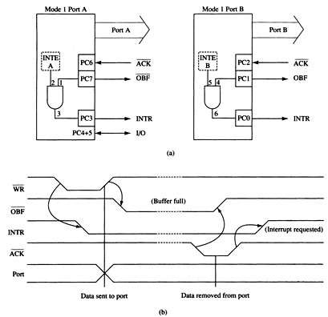
Figure 11–29 Strobed output operation (mode 1) of the 82C55. (a) Internal structure and (b) timing diagram.

Slide 104
Signal Definitions for Mode 1 Strobed Output
OBF
Output buffer full goes low whenever data are output (OUT) to the port A or B latch. The signal is set to logic 1 when the ACK pulse returns from the external device.

Slide 105
ACK
The acknowledge signal causes the OBF
pin to return to logic 1. The ACK signal is a response from an external device, indicating that it has received data from the 82C55 port.
INTR
Interrupt request often interrupts the processor when the external device receives the data via the ACK signal. Qualified by the internal INTE (interrupt enable) bit.

Slide 106
INTE
Interrupt enable is neither input nor output;
it is an internal bit programmed to enable or disable the INTR pin. INTE A is programmed using PC₆ bit. INTE B is programmed using the PC₂ bit.
PC₄, PC₅
Port C pins PC₄ and PC₅ are general-purpose I/O pins. The bit set and reset command is used to set or reset these two pins.

Slide 107
Strobed Output Example
The printer interface demonstrates how to achieve strobed output synchronization between the printer and the 82C55.
Figure 11–30 illustrates port B connected to
a parallel printer, with eight data inputs for receiving ASCII-coded data, a DS (data strobe) input to strobe data into the printer, and an ACK output to acknowledge the
receipt of the ASCII character.

Slide 108
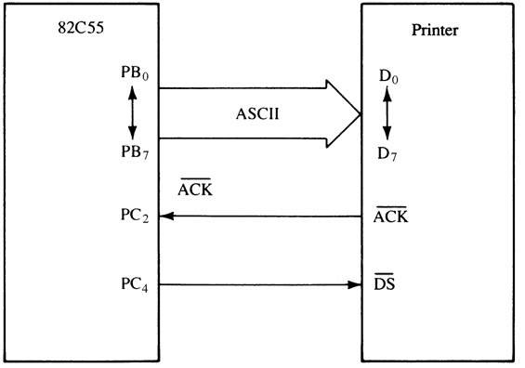
Figure 11–30 The 82C55 connected to a parallel printer interface that illustrates the strobed output mode of operation for the 82C55.

Slide 109
Mode 2 Bidirectional Operation
Mode 2 is allowed with group A only.
Port A becomes bidirectional, allowing data transmit/receive over the same eight wires.
  useful when interfacing two computers
Also used for IEEE-488 parallel high-speed GPIB (general- purpose instrumentation bus) interface standard.
Figure 11–31 shows internal structure and timing for mode 2 bidirectional operation.

Slide 110
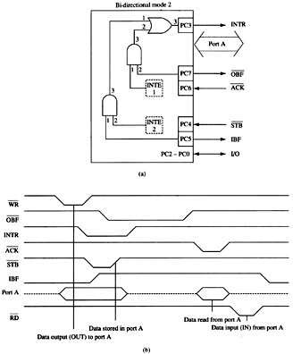
Figure 11–31 Mode 2 operation of the 82C55. (a) Internal structure and (b) timing diagram.

Slide 111
Signal Definitions for Bidirectional Mode 2
INTR
Interrupt request is an output used to interrupt the microprocessor for input
and output conditions.
OBF
Output buffer full is an output indicating
the output buffer contains data for the bidirectional bus.

Slide 112
ACK
Acknowledge is an input that enables the three-state buffers so that data can appear
on port A. If ACK is logic 1, the output buffers of port A are at their high-impedance state.
STB
The strobe input loads the port A input latch with external data from the bidirectional
port A bus.

Slide 113
PC₀, PC₁, and PC₂
These pins are general-purpose I/O pins in mode 2 controlled by the bit set and reset command.

Slide 114
IBF
Input buffer full is an output used to signal that the input buffer contains data for the external bidirectional bus.
INTE
Interrupt enable are internal bits (INTE1 & INTE2) that enable the INTR pin. The state
of the INTR pin is controlled through port C bits PC₆ (INTE1) and PC₄ (INTE2).

Slide 115
The Bidirectional Bus
The bidirectional bus is used by referencing port A with the IN and OUT instructions.
To transmit data through the bidirectional bus, the program first tests to determine whether the output buffer is empty.
  if so, data are sent to the output buffer via OUT
The external circuitry also monitors the signal to decide whether the microprocessor has sent data to the bus.

Slide 116
To receive data through the bidirectional port A bus, IBF is tested with software to decide whether data have been strobed into the port.
  if IBF = 1, data is input using IN
The external interface sends data to the port by using the STB signal.
  the IBF signal becomes logic 1 and data at
  port A are held inside the port in a latch
When the IN executes, the IBF bit is cleared and data in the port are moved into AL.
See Example 11–21 for a procedure.

Slide 117
The INTR (interrupt request) pin can be activated from both directions of data flow through the bus.
If INTR is enabled by both INTE bits, the output and input buffers both cause interrupt requests.
This occurs when data are strobed into the buffer using STB or when data are written using OUT.

Slide 118
82C55 Mode Summary
Figure 11–32 shows a graphical summary of the three modes of operation for the 82C55.
Mode 0 provides simple I/O.
Mode 1 provides strobed I/O.
Mode 2 provides bidirectional I/O.
These modes are selected through the command register of the 82C55.

Slide 119
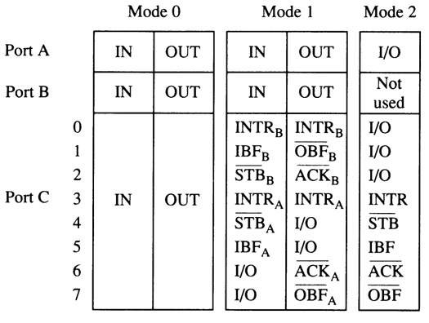
Figure 11–32 A summary of the port connections for the 82C55 PIA.

Slide 120
The Serial EEPROM Interface
In Chapter 10, Figure 10–23, a serial EEPROM is illustrated, but at that point in
the text, no I/O existed for an interface.
Suppose that port C of an 82C55 is used for connection to this interface and software is needed to drive the interface.
The PC₀ pin is programmed as an output to send data and as an input to receive data
from the EEPROM.

Slide 121
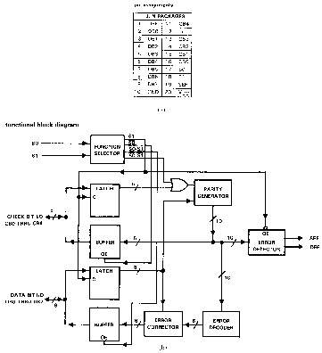
Chapter 10, Figure 10–23 A serial EEPROM interface.
  this memory interface
  has two signal lines
  one is a serial clock (SCL); the other a bidirectional serial data line (SDA)
  not meant to replace system main memory
  it is fast enough for music or other low-speed data

Slide 122
Refer to Figure 10–24.
The data format for the software for reading and writing data to the EEPROM is also illustrated in Example 11–22.
This software is written in C with some assembly language, but it can also be developed in assembly language.
I/O port address for the command register is 0x1203, and 0x1202 for the port C register.
  the time delay should be 1.25 µs for a data
  rate of 400 KHz

Slide 123
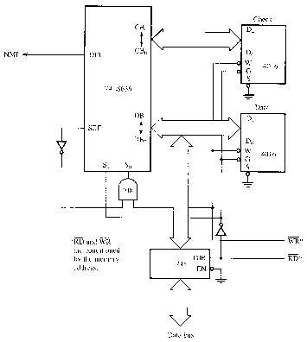
Chapter 10, Figure 10–24 Data signals to the serial EEPROM for a read or a write.
  the serial data contains the address in the first byte as well as a device code of 1010, which represents the EEPROM
  other serial devices have different device codes
  this is followed by the memory location and the data in additional bytes

Slide 124
11–4 8254 PROGRAMMABLE INTERVAL TIMER
The 8254 consists of three independent
16-bit programmable counters (timers).
Each counter is capable of counting in binary or binary-coded decimal (BCD).
  maximum allowable input frequency to any
  counter is 10 MHz
Useful where the microprocessor must
control real-time events.

Slide 125
Usage includes real-time clocks, event counters, and motor speed/direction control.
Timer appears in the PC decoded at ports 40H–43H to do the following:
  1. Generate a basic timer interrupt that occurs
  at approximately 18.2 Hz
  2. Cause the DRAM memory system to be refreshed
  3. Provide a timing source to the internal
  speaker and other devices.
Timer in the PC is an 8253 instead of 8254.

Slide 126
8254 Functional Description
Figure 11–33 shows the pin-out of the 8254,
a higher-speed version of the 8253, and a diagram of one of the three counters.
Each timer contains:
  a CLK input which provides the basic operating frequency to the timer
  a gate input pin which controls the timer in some modes
  an output (OUT) connection to obtain the output
  of the timer

Slide 127
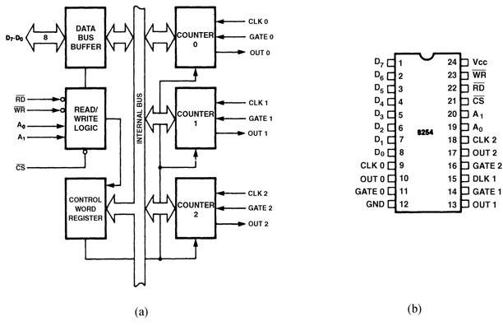
Figure 11–33 The 8254 programmable interval timer. (a) Internal structure and (b) pin-out. (Courtesy of Intel Corporation.)

Slide 128
The signals that connect to the processor are the data bus pins (D₇–D₀), RD, WR, CS, and address inputs A₁ and A₀.
Address inputs are present to select any of the four internal registers.
  used for programming, reading, or writing to a counter

Slide 129
Timer zero generates an 18.2 Hz signal that interrupts the microprocessor at interrupt vector 8 for a clock tick.
  often used to time programs and events in DOS
Timer 1 is programmed for 15 µs, used on
the PC to request a DMA action used to refresh the dynamic RAM.
Timer 2 is programmed to generate a tone
on the PC speaker.

Slide 130
Pin Definitions for 8254
A₀, A₁
The address inputs select one of four internal registers within the 8254. See Table 11–4 for the function of the A₁ and A₀ address bits.
CLK
The clock input is the timing source for each of the internal counters. This input is often connected to the PCLK signal from the microprocessor system bus controller.

Slide 131
CS
Chip select enables 8254 for programming and reading or writing a counter.
G
The gate input controls the operation of the counter in some modes of operation
GND
Ground connects to the system ground bus.

Slide 132
OUT
A counter output is where the waveform generated by the timer is available.
RD
Read causes data to be read from the 8254 and often connects to the IORC signal.
Vcc
Power connects to the +5.0 V power supply.

Slide 133
WR
Write causes data to be written to the 8254 and often connects to write strobe IOWC.

Slide 134
Programming the 8254
Each counter is programmed by writing a control word, followed by the initial count.
  fig 11–34 lists the program control word structure
The control word allows the programmer to select the counter, mode of operation, and type of operation (read/write).
  also selects either a binary or BCD count

Slide 135
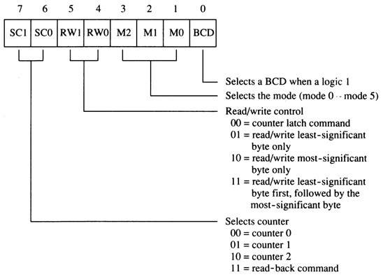
Figure 11–34 The control word for the 8254-2 timer.

Slide 136
Each counter may be programmed with a count of 1 to FFFFH; A count of 0 is equal
to FFFFH+l (65,536) or 10,000 in BCD.
Timer 0 is used in the PC with a divide-by count of 64K (FFFFH) to generate the
18.2 Hz (18.196 Hz) interrupt clock tick.
  timer 0 has a clock input frequency of
  4.77 MHz + 4 or 1.1925 MHz
The order of programming is important for each counter, but programming of different counters may be interleaved for better control.

Slide 137
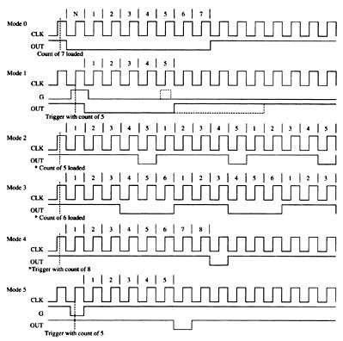
Figure 11–35 The six modes of operation for the 8254-2 programmable interval timer. The G input stops the count when 0 in modes 2, 3, and 4.
Modes of Operation
  six modes (0–5) of available to each of the 8254 counters
  each mode functions with the CLK input, the gate (G) control
  signal, and OUT signal

Slide 138
Mode 0
Allows 8254 to be used as an events counter.
Output becomes logic 0 when the control
word is written and remains until N plus the number of programmed counts.
Note that gate (G) input must be logic 1 to allow the counter to count.
If G becomes logic 0 in the middle of the count, the counter will stop until G again becomes logic 1.

Slide 139
Mode 1
Causes function as a retriggerable, monostable multivibrator (one-shot).
G input triggers the counter so it develops a pulse at the OUT connection that becomes logic 0 for the duration of the count.
  if the count is 10, the OUT connection goes
  low for 10 clocking periods when triggered
If G input occurs within the output pulse, the counter is reloaded and the OUT connection continues for the total length of the count.

Slide 140
Mode 2
Allows the counter to generate a series of continuous pulses one clock pulse wide.
  pulse separation is determined by the count
For a count of 10, output is logic 1 for nine clock periods and low for one clock period.
The cycle is repeated until the counter is programmed with a new count or until the G pin is placed at logic 0.
  G input must be logic 1 for this mode to
  generate a continuous series of pulses

Slide 141
Mode 3
Generates a continuous square wave at the OUT connection, provided the G pin is logic 1.
If the count is even, output is high for one half of the count and low for one half of the count.
If the count is odd, output is high for one clocking period longer than it is low.
  if the counter is programmed for a count of 5,
  the output is high for three clocks and low for
  two clocks

Slide 142
Mode 4
Allows a single pulse at the output.
If count is programmed as 10, output is high for 10 clocking periods and low for one period.
  the cycle does not begin until the counter
  is loaded with its complete count
Operates as a software triggered one-shot.
As with modes 2 and 3, this mode also uses the G input to enable the counter.
  G input must be logic 1 for the counter to
  operate for these three modes

Slide 143
Mode 5
A hardware triggered one-shot that functions as mode 4.
  except it is started by a trigger pulse on the
  G pin instead of by software
This mode is also similar to mode 1 because
it is retriggerable.

Slide 144
Generating a Waveform with the 8254
Fig 11–36 shows an 8254 connected to I/O ports 0700H, 0702H, 0704H, and 0706H of an 80386SX.
The addresses are decoded by using a PLD that also generates a write strobe signal for the 8254, which is connected to the low-order data bus connections.

Slide 145
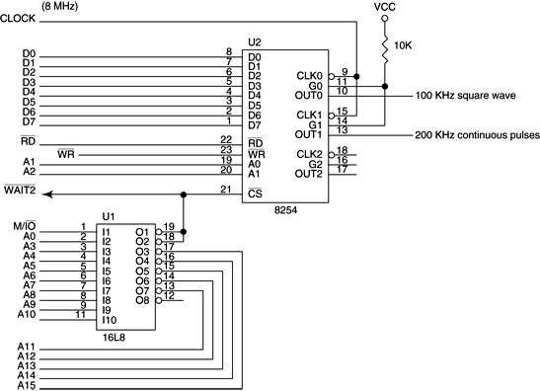
Figure 11–36 The 8254 interfaced to an 8 MHz 8086 so that it generates a 100 KHz square wave at OUT0 and a 200 KHz continuous pulse at OUT1.

Slide 146
The PLD also generates a wait signal for the microprocessor that causes two wait states when the 8254 is accessed.
The wait state generator connected to the microprocessor actually controls the number of wait states inserted into the timing.
Example 11–24 lists the program that generates a 100 KHz square-wave at OUT0 and a 200 KHz continuous pulse at OUT1.

Slide 147
Reading a Counter
Each counter has an internal latch read with the read counter port operation.
  the latches will normally follow the count
If counter contents are needed, the latch can remember the count by programming the counter latch control word.
See Figure 11–37.
  counter contents are held in a latch until read

Slide 148
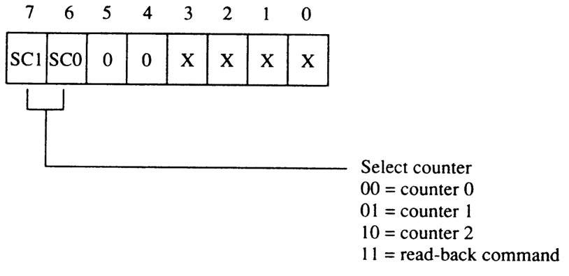
Figure 11–37 The 8254-2 counter latch control word.

Slide 149
When a read from the latch or counter is programmed, the latch tracks the contents.
When necessary for contents of more than one counter to be read at the same time, the read-back control word is used
Illustrated in Figure 11–38.

Slide 150
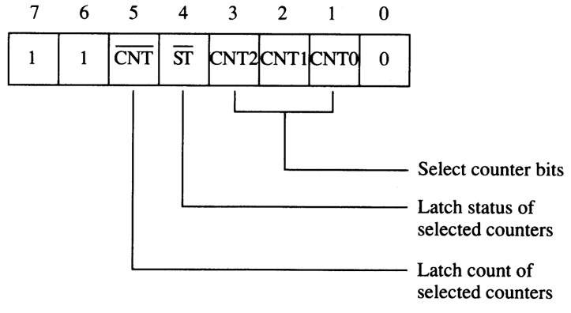
Figure 11–38 The 8254-2 read-back control word.

Slide 151
With the read-back control word, the CNT bit is logic 0 to cause the counters selected by CNT0, CNT1, and CNT2 to be latched.
If the status register is to be latched, then the bit is placed at logic 0.
Figure 11–39 shows the status register,
which shows:
  the state of the output pin
  whether the counter is at its null state (0)
  how the counter is programmed

Slide 152
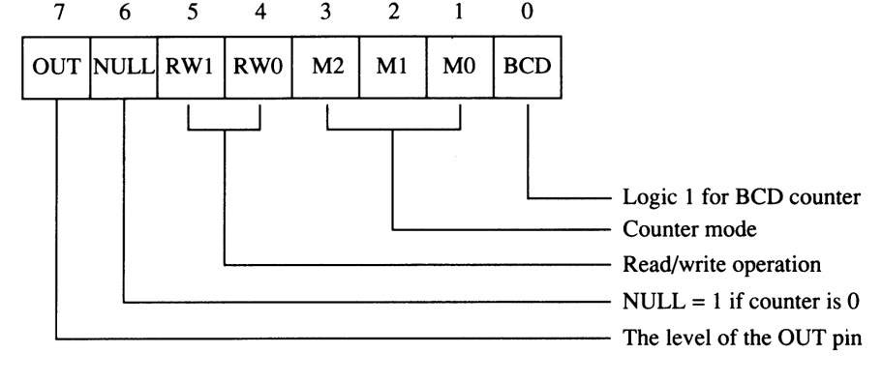
Figure 11–39 The 8254-2 status register.

Slide 153
DC Motor Speed and Direction Control
An application of 8254 is as a motor speed controller for a DC motor.
Fig 11–40 shows the schematic diagram
of the motor and associated driver circuitry.
It also illustrates the interconnection of the 8254, a flip-flop, and the motor and its driver.

Slide 154
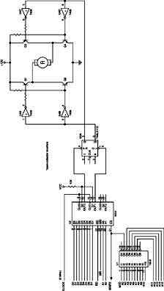
Figure 11–40 Motor speed and direction control using the 8254 timer.
  if Q output of the 74ALS112 is logic 1,
  the motor spins in its forward direction
  if logic 0, the motor spins in reverse
  if flip-flop output alternates between
  logic 1 and 0, the motor spins in either direction at various speeds
  if the duty cycle of the Q output is 50%, the motor will not spin at all and
  exhibits some holding torque

Slide 155
Fig 11–41 shows some timing diagrams and effects on the speed/direction of the motor.
Each counter generates pulses at different positions to vary the duty cycle at the Q output of the flip-flop.
This output is also called pulse width modulation.
Example 11–25 lists a procedure that controls the speed and direction of the motor.

Slide 156
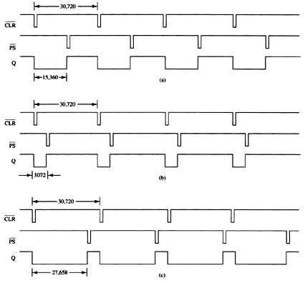
Figure 11–41 Timing for the motor speed and direction control circuit of Figure 11–40. (a) No rotation, (b) high-speed rotation in the reverse direction, and (c) high-speed rotation in the forward direction.

Slide 157
11–5 16550 PROGRAMMABLE COMMUNICATIONS INTERFACE
National Semiconductor Corp’s PC16550D
is a programmable communications interface designed to connect to virtually any type of serial interface.
16550 is a universal asynchronous receiver/transmitter (UART) fully compatible with Intel microprocessors.

Slide 158
16550 operates at 0–1.5 M baud.
  baud rate is bps (bits transferred per second) including start, stop, data, and parity
  bps are bits per second; Bps is bytes per second
16550 also includes a programmable baud rate generator and separate FIFOs for input and output data to ease the load on the microprocessor.
Each FIFO contains 16 bytes of storage.
The most common communications interface found in the PC and many modems.

Slide 159
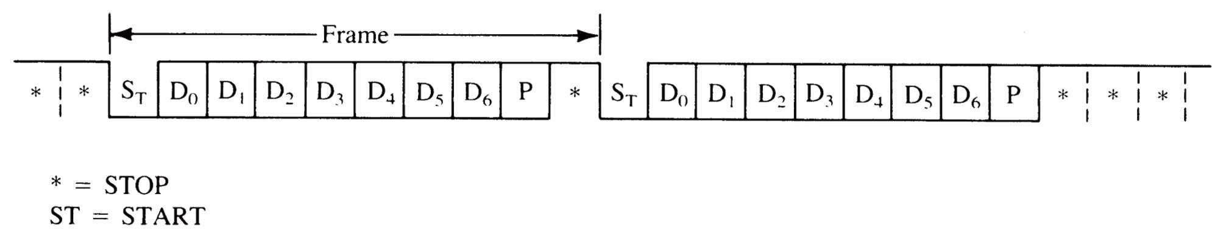
Figure 11–42 Asynchronous serial data.
Asynchronous Serial Data
Asynchronous serial data are transmitted and received without a clock or timing signal.
  shown here are two frames of asynchronous
  serial data
  each frame contains a start bit, seven data bits, parity, and one stop bit

Slide 160
Dial-up communications systems of the past, such as CompuServe, Prodigy, and America Online, used 10 bits for asynchronous serial data with even parity.
Most Internet and BBS services use 10 bits, but normally do not use parity.
  instead, eight data bits are transferred, replacing parity with a data bit
This makes byte transfers of non-ASCII data much easier to accomplish.

Slide 161
16550 Functional Description
Fig 11–43 shows pin-outs of a 16550 UART.
The device is available as a 40-pin DIP
(dual in-line package) or as a 44-pin PLCC (plastic leadless chip carrier).
Two completely separate sections are responsible for data communications.
  the receiver and the transmitter
Because each sections is independent, 16550 is able to function in simplex, half-duplex, or full-duplex modes.

Slide 162
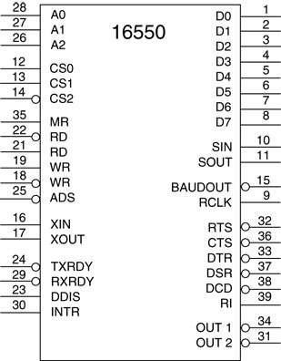
Figure 11–43 The pin-out of the 16550 UART.

Slide 163
A major feature of the 16550 is its internal receiver and transmitter FIFO (first-in, first-out) memories.
Because each is 16 bytes deep, the UART requires attention from the processor only after receiving 16 bytes of data.
  also holds 16 bytes before the processor
  must wait for the transmitter
The FIFO makes this UART ideal when interfacing to high-speed systems because less time is required to service it.

Slide 164
A simplex system is one in which the transmitter or receiver is used by itself.
  such as in an FM (frequency modulation)
  radio station
A half-duplex system is a CB (citizens band) radio.
  transmit and receive, but not at the same time
A full-duplex system allows transmission
and reception in both directions simultaneously.
  the telephone is a full-duplex system

Slide 165
The 16550 can control a modem (modulator/demodulator), a device that converts TTL serial data into audio tones
that can pass through the telephone system.
Six pins on 16650 are for modem control: DSR (data set ready), DTR (data terminal ready), CTS (clear-to-send), RTS (request-to-send), RI (ring indicator), and DCD (data carrier detect).
The modem is referred to as the data set and the 16550 is referred to as the data terminal.

Slide 166
16550 Pin Functions
A₀, A₁, A₂
The address inputs are used to select an internal register for programming and also data transfer.
See Table 11–5 for a list of each
combination of the address inputs and
the registers selected.

Slide 167
ADS
The address strobe input is used to latch
the address lines and chip select lines.
If not needed (as in the Intel system),
connect this pin to ground.
The ADS pin is designed for use with
Motorola microprocessors.

Slide 168
BAUDOUT
The baud out pin is where the clock signal generated by the baud rate generator from
the transmitter section is made available.
It is most often connected to the RCLK input to generate a receiver clock that is equal to the transmitter clock.

Slide 169
CS₀, CS₁, CS₂
The chip select inputs must all be active to enable the 16550 UART.
CTS
The clear-to-send (if low) indicates that the modem or data set is ready to exchange information.
This pin is often used in a half-duplex system to turn the line around.

Slide 170
D₀–D₇
The data bus pins are connected to the microprocessor data bus.
DCD
Data carrier detect input is used by the modem to signal the 16550 that a carrier
is present.

Slide 171
DTR
Data terminal ready is an output that indicates that the data terminal (16550)
is ready to function.
INTR
Interrupt request is an output to the microprocessor used to request an interrupt (INTR=1) when the 16550 has a receiver error, it has received data, and the
transmitter is empty.

Slide 172
DDIS
The disable driver output becomes logic 0
to indicate the microprocessor is reading
data from the UART.
DDIS can be used to change the direction
of data flow through a buffer.
DSR
Data set ready is an input to the 16550, indicating that the modem or data set is
ready to operate.

Slide 173
MR
Master reset initializes the 16550 and should be connected to the system RESET signal.
OUT1, OUT2
User-defined output pins that can provide signals to a modem or any other device as needed in a system.
RCLCK
Receiver clock is the clock input to the receiver section of the UART.

Slide 174
RD, RD
Read inputs (either may be used) cause data to be read from the register specified by the address inputs to the UART.
RI
Ring indicator input is placed at logic 0 by
the modem to indicate the phone is ringing.
RTS
Request-to-send is a signal to the modem indicating that the UART wishes to send data.

Slide 175
SIN, SOUT
These are the serial data pins. SIN accepts serial data and SOUT transmits serial data.
RXRDY
Receiver ready is a signal used to transfer received data via DMA techniques.
TXRDY
Transmitter ready is a signal used to
transfer transmitter data via DMA.

Slide 176
WR, WR
Write (either may be used) connects to the microprocessor write signal to transfer commands and data to the 16550.
XIN, XOUT
These are the main clock connections.
A crystal is connected across these pins to form a crystal oscillator, or XIN is connected
to an external timing source.

Slide 177
Programming the 16550
Programming is a two-part process & includes the initialization dialog and operational dialog.
In the PC, which uses the 16550 or its programming equivalent, I/O port addresses are decoded at 3F8H - 3FFH for COM port 0 and 2F8H - 2FFH for COM port 2.

Slide 178
Initializing the 16550
Initialization dialog after a hardware or software reset, consists of two parts:
  programming the line control register
  programming the baud rate generator
The line control register selects the number
of data bits, stop bits, and parity (whether even or odd, or if parity is sent as a 1 or a 0)
Baud rate generator is programmed with a divisor that determines the baud rate of the transmitter section.

Slide 179
Fig 11–44 illustrates the line control register.
The line control register is programmed by outputting information to port 011 (A₂, A₁, A₀).
The rightmost two bits of the line control register select the number of transmitted
data bits (5, 6, 7, or 8).
Number of stop bits is selected by S in the line control register.
  if S = 0, one stop bit is used
  if S = 1, 1.5 stop bits are used for five data bits,
  & two stop bits with six, seven, or eight data bits

Slide 180
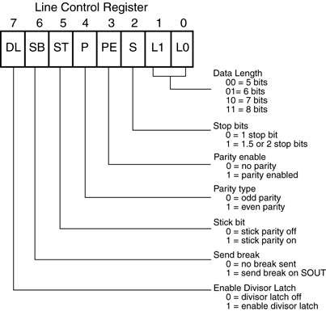
Figure 11–44 The contents of the 16550 line control register.

Slide 181
Programming the Baud Rate
The baud rate generator is programmed at
I/O addresses 000 and 001 (A₂, A₁, A₀).
Port 000 is used to hold the least significant part of the 16-bit divisor and port 001 is used to hold the most significant part.
  value used for the divisor depends on the
  external clock or crystal frequency
Table 11–7 illustrates common baud rates obtainable if an 18.432 MHz crystal is used
as a timing source.

Slide 182
Sample Initialization
Suppose an asynchronous system requires seven data bits, odd parity a baud rate of 9600, and one stop bit.
Example 11–24 lists a procedure to initialize the 16550 to function in this manner.
Fig 11–45 shows the interface to the 8088 microprocessor, using a PLD to decode the
8-bit port addresses F0H through F7H.

Slide 183
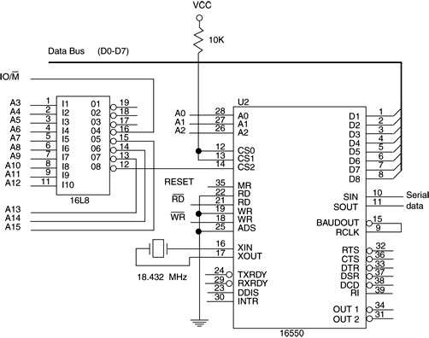
Figure 11–45 The 16550 interfaced to the 8088 microprocessor at ports 00F0H–00F7H.

Slide 184
After the line control register and baud rate divisor are programmed into the 16550, it
is still not ready to function.
The FIFO control register must still be programmed.
  at port F2H in the circuit of Figure 11–45
Fig 11–46 illustrates the FIFO control register for the 16550.
  the register enables the transmitter & receiver
  (bit 0=1), clears the transmitter & receiver FIFOs
  it also provides control for the 16550 interrupts

Slide 185
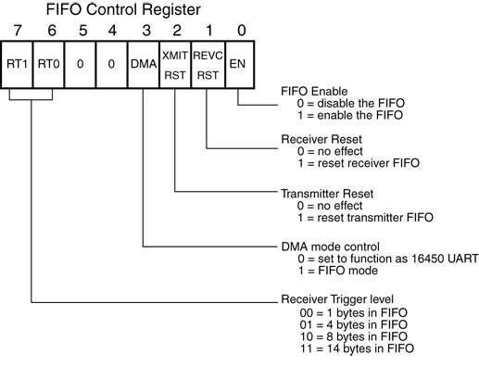
Figure 11–46 The FIFO control register of the 16550 UART.

Slide 186
The last section of Example 11–26 places a
7 into the FIFO control register.
This enables the transmitter and receiver,
and clears both FIFOs.
The 16550 is now ready to operate, but without interrupts.
  interrupts are automatically disabled when
  the MR (master reset) input is placed at logic 1
  by the system RESET signal.

Slide 187
Sending Serial Data
Before serial data can be sent or received,
we need to know the function of the line
status register
  see Figure 11–47
The line status register contains information about error conditions and the state of the transmitter and receiver.
This register is tested before a byte is transmitted or can be received.

Slide 188
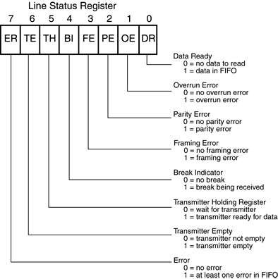
Figure 11–47 The contents of the line status register of the 16550 UART.

Slide 189
Receiving Serial Data
To read received information from the 16550, test the DR bit of the line status register.
  example 11–28 lists a procedure to test the DR
  bit to decide if the 16550 has received any data
Upon the reception of data, the procedure tests for errors.
  if an error is detected, the procedure returns
  with AL equal to an ASCII ‘?’
  if no error has occurred, the procedure returns with AL equal to the received character

Slide 190
UART Errors
Errors detected by 16550 are:
  parity, framing, and overrun errors
These errors should not occur during
normal operation.
A parity error indicates the received data contain the wrong parity.
  if a parity error occurs, it indicates noise
  was encountered during reception

Slide 191
A framing error indicates the start and stop bits are not in their proper places.
  occurs if the receiver is receiving data at
  an incorrect baud rate
An overrun error indicates data have
overrun the internal receiver FIFO buffer.
  occurs only if the software fails to read the data from the UART before the receiver FIFO is full

Slide 192
11–6 ANALOG-TO-DIGITAL (ADC)
& DIGITAL-TO-ANALOG (DAC) CONVERTERS
These devices are used to interface the microprocessor to the analog world.
Many events monitored and controlled by
the microprocessor are analog events.
These range from monitoring all forms of events, even speech, to controlling motors
and like devices.

Slide 193
The DAC0830 Digital-to-Analog Converter
A fairly common and low-cost digital-to-analog converter is the DAC0830.
  a product of National Semiconductor Corp
An 8-bit converter that transforms an 8-bit binary number into an analog voltage.
Other converters are available that convert from 10-, 12-, or 16-bit binary numbers into analog voltages.

Slide 194
The number of voltage steps generated by
the converter is equal to the number of
binary input combinations.
  an 8-bit converter generates 256 voltage levels
  a 10-bit converter generates 1024 levels
The DAC0830 is a medium-speed converter that transforms a digital input to an analog output in approximately 1.0 µs.

Slide 195
Figure 11–48 shows pin-outs of a DAC0830.
The device has eight data bus connections
for the application of the digital input code.
Analog outputs labeled IOUT1 & IOUT2 are inputs to an external operational amplifier.
Because this is an 8-bit converter, its output step voltage is defined as –V_{REF} (reference voltage), divided by 255.
  the step voltage is often called the resolution
  of the converter

Slide 196
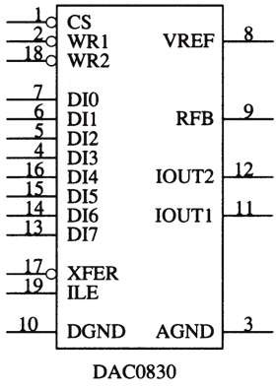
Figure 11–48 The pin-out of the DAC0830 digital-to-analog converter.

Slide 197
Internal Structure of the DAC0830
Fig 11–49 shows the internal structure.
This device contains two internal registers.
  the first is a holding register
  the second connects to the R–2R internal
  ladder converter
The two latches allow one byte to be held while another is converted.
The first latch is often disabled and the
second for entering data into the converter.

Slide 198

Figure 11–49 The internal structure of the DAC0830.

Slide 199
Both latches within the DAC0830 are transparent latches.
  when G input is logic 1, data pass through
  when G input becomes logic 0, data are latched
The output of the R–2R ladder within the converter appears at IOUT1 and IOUT2.
These outputs are designed to be applied
to an operational amplifier such as a 741
or similar device.

Slide 200
Connecting the DAC0830 to the Microprocessor.
A PLD is used to decode the DAC0830 at I/O port address 20H.
  when an OUT 20H,AL instruction is executed, contents of data bus connections AD₀–AD₇ are passed to the converter in the DAC0830
The 741 operational amplifier, along with the –12 V zener reference voltage, causes the full-scale output voltage to equal +12 V.
See Fig 11–50.

Slide 201

Figure 11–50 A DAC0830 interfaced to the 8086 microprocessor at 8-bit I/O location 20H.

Slide 202
The ADC080X Analog-to-Digital Converter
A common, low-cost ADC, compatible with a wide range of microprocessors.
  while there are faster ADCs available with more resolution, this device is ideal for applications
  that do not require a high degree of accuracy
ADC080X requires up to 100 µs to convert an analog input voltage into a digital output code.
Figure 11–51 shows the pin-out of the ADC0804 converter.

Slide 203

Figure 11–51 The pin-out of the ADC0804 analog-to-digital converter.

Slide 204
To operate the converter, the WR pin is pulsed with CS grounded to start the conversion process.
See Fig 11–52 for a timing diagram that shows the interaction of the control signals.
If a time delay is used that allows at least 100 µs of time, there is no need to test INTR pin.
Another option is to connect the INTR pin to an interrupt input, so when the conversion is complete, an interrupt occurs.

Slide 205

Figure 11–52 The timing diagram for the ADC0804 analog-to-digital converter.

Slide 206
The Analog Input Signal
Before ADC0804 can be connected, the two analog inputs must be understood:
  VIN(+) and VIN(–)
These differential inputs are summed by the operational amplifier to produce a signal for the internal analog-to-digital converter.
These inputs are connected to an internal operational amplifier as shown in Fig 11–53.

Slide 207

Figure 11–53 The analog inputs to the ADC0804 converter. (a) To sense a 0- to +5.0 V input. (b) To sense an input offset from ground.

Slide 208
Generating the Clock Signal
ADC0804 requires a clock source to operate.
It can be an external clock applied to CLK IN pin or can be generated with an RC circuit.
  permissible range of clock frequencies is
  100 KHz - 1460 KHz.
  desirable to use a frequency as close as possible to 1460 KHz so conversion time is minimized
If generated with an RC circuit, CLK IN and CLK R pins are connected to an RC circuit,
as illustrated in Figure 11–54.

Slide 209

Figure 11–54 Connecting the RC circuit to the CLK IN and CLK R pins on the ADC0804.

Slide 210
Connecting the ADC0804 to the Microprocessor
ADC0804 interfaced to an 8086 is illustrated
in Figure 11–55.
  V_{REF} is not attached to anything, which is normal
Suppose ADC0804 is decoded at I/O port address 40H for the data and address 42H
for INTR.
The procedure to read data is listed in Example 11–29.

Slide 211

Figure 11–55 The ADC0804 interfaced to the 8086 microprocessor.

Slide 212
Using the ADC0804 and the DAC0830
This illustrates an example using an ADC0804 and a DAC0830 to capture and replay audio signals or speech.
  a speech synthesizer has been used in the past
  to generate speech, but quality was poor
For human quality speech, we can use an ADC0804 to capture an audio signal and
store it for later playback through a DAC0830.

Slide 213
Fig 11–56 shows circuitry required to connect the ADC0804 at I/O ports 0700H and 0702H.
The DAC0830 is interfaced at I/O port 704H.
  These ports are in the low bank of a 16-bit microprocessor such as the 8086/80386SX
The software appears in Example 11–30.
It reads a 1-second burst of speech and
plays it back 10 times.

Slide 214

Figure 11–56 A circuit that stores speech and plays it back through the speaker.

Slide 215
A procedure called READS reads the speech.
A second, PLAYS, plays it back.
The speech is sampled and stored in a section of memory called WORDS.
The sample rate is chosen at 2048 samples per second, which renders acceptable-sounding speech.

Slide 216
SUMMARY
The 8086-Core2 microprocessors have two basic types of I/O instructions: IN and OUT.
The IN instruction inputs data from an external I/O device into either the AL (8-bit) or AX (16-bit) register.
The IN instruction is available as a fixed port instruction, a variable port instruction, or a string instruction (80286-Pentium 4) INSB or INSW.

Slide 217
SUMMARY
(cont.)
The OUT instruction outputs data from AL or AX to an external I/O device and is available as a fixed, variable, or string instruction OUTSB or OUTSW.
The fixed port instruction uses an 8-bit I/O port address, while the variable and string I/O instructions use a 16-bit port number found in the DX register.

Slide 218
SUMMARY
(cont.)
Isolated I/O, sometimes called direct I/O, uses a separate map for the I/O space, freeing the entire memory for use by the program.
Isolated I/O uses the IN and OUT instructions to transfer data between the I/O device and the micro-processor.

Slide 219
SUMMARY
(cont.)
Memory-mapped I/O uses a portion of the memory space for I/O transfers.
In addition, any instruction that addresses a memory location using any addressing mode can be used to transfer data between the microprocessor and the I/O device using memory-mapped I/O.

Slide 220
SUMMARY
(cont.)
All input devices are buffered so that the I/O data are connected only to the data bus during the execution of the IN instruction.
The buffer is either built into a programmable peripheral or located separately.
All output devices use a latch to capture output data during the execution of the OUT instruction.

Slide 221
SUMMARY
(cont.)
Handshaking or polling is the act of two independent devices synchronizing with a few control lines.
This communication between the computer and the printer is a handshake or a poll.
Interfaces are required for most switch-based input devices and for most output devices that are not TTL-compatible.

Slide 222
SUMMARY
(cont.)
The I/O port number appears on address bus connections A7-A0 for a fixed port I/O instruction and on A15-A0 for a variable port I/O instruction (note that A15-A8 contains zeros for an 8-bit port).
In both cases, address bits above A15 are undefined.

Slide 223
SUMMARY
(cont.)
Because the 8086/80286/80386SX microprocessors contain a 16-bit data bus and the I/O addresses reference byte-sized I/O locations, I/O space is also organized in banks, as is the memory system.
In order to interface an 8-bit I/O device to the 16-bit data bus, we often require separate write strobes (an upper and a lower) for I/O write operations.

Slide 224
SUMMARY
(cont.)
The I/O port decoder is much like the memory address decoder, except instead of decoding the entire address, the I/O port decoder decodes only a 16-bit address for variable port instructions and often an 8-bit port number for fixed I/O instructions.
The 82C55 is a programmable peripheral interface (PIA) that has 24 I/O pins that are programmable in two groups of 12 pins each (group A and group B).

Slide 225
SUMMARY
(cont.)
The 82C55 operates in three modes: simple I/O (mode 0), strobed I/O (mode 1), and bidirectional I/O (mode 2).
When the 82C55 is interfaced to the 8086 operating at 8 MHz, we insert two wait states because the speed of is faster than the 82C55 can handle.
The LCD display device requires a fair amount of software, but it displays AS-CII-coded information.

Slide 226
SUMMARY
(cont.)
The 8254 is a programmable interval timer with three 16-bit counters that count in binary or binary-coded decimal (BCD).
Each counter is independent and operates in six different modes: (1) events counter, (2) retriggerable, monostable multivibrator, (3) pulse generator, (4) square-wave generator, (5) software-triggered pulse generator, and (6) hardware-triggered pulse generator.

Slide 227
SUMMARY
The 16550 is a programmable communications interface, capable of receiving and transmitting asynchronous serial data.
The DAC0830 is an 8-bit digital-to-analog converter that converts a digital signal to an analog voltage within 1.0 µs.
The ADC0804 is an 8-bit analog-to-digital converter that converts an analog signal into a digital signal within 100 µs.

